Slide 1

CS 533 INTRO TO DATA SCIENCE
Michael Ekstrand

Slide 2
DECOMPOSING MATRICES

Slide 3

Learning Outcomes
Review matrix multiplication
Decompose a matrix into a lower-rank approximation
Photo by Carissa Weiser on Unsplash

Slide 4
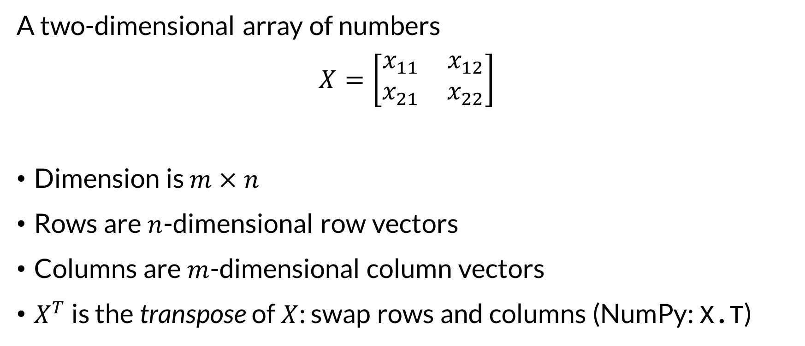

What Is a Matrix?
A two-dimensional array of numbers
$$X=\left[\begin{matrix}x_{11} & x_{12} \\ x_{21} & x_{22}\end{matrix}\right]$$
Dimension is $m×n$
Rows are $n$-dimensional row vectors
Columns are $m$-dimensional column vectors
$X^{T}$ is the transpose of $X$: swap rows and columns (NumPy: X.T)

Slide 5

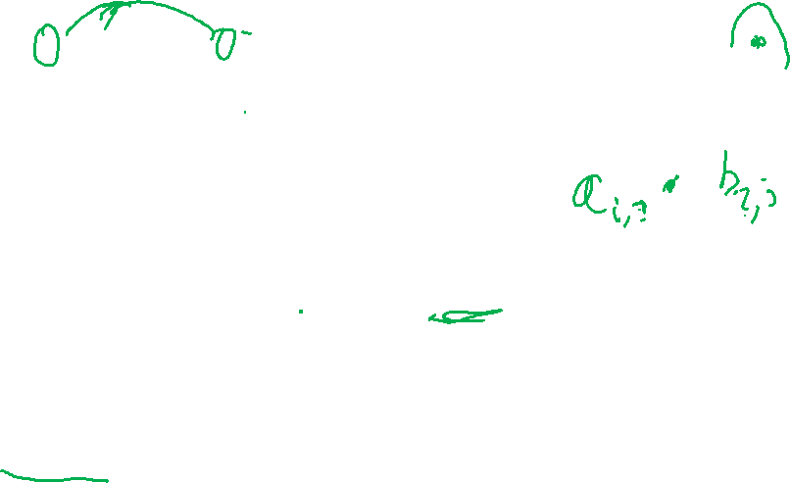
Matrix Multiplication
If $A∈ℝ^{m×k}$ and $B∈ℝ^{k×n}$, then the matrix product $C=AB∈ℝ^{m×n}$
Defined by:
$$c_{ij}=\sum_{l=1}^{k}{a_{il}b_{li}}$$
NumPy: A @ B

Slide 6

Sparse Matrix
A matrix is sparse (mathematically) if most values are 0.
Sparse matrix representations only store nonzero values
scipy.sparse
np.ndarray is our dense matrix
DataFrame and Series cannot be sparse 😔 (they store 0s)

Slide 7
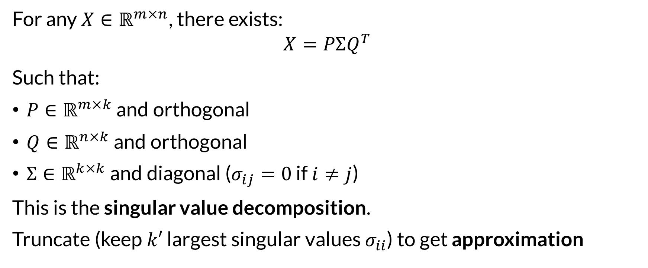
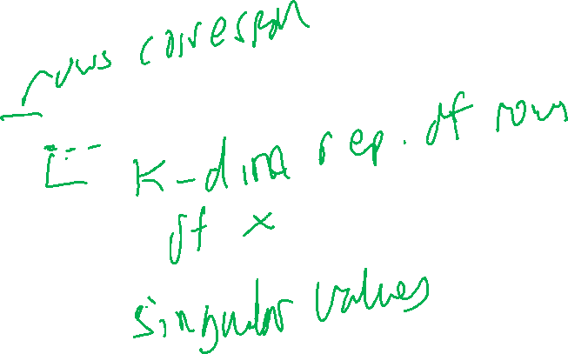
Dimensionality Reduction
For any $X∈ℝ^{m×n}$, there exists:
$$X=PΣQ^{T}$$
Such that:
$P∈ℝ^{m×k}$ and orthogonal
$Q∈ℝ^{n×k}$ and orthogonal
$Σ∈ℝ^{k×k}$ and diagonal ($σ_{ij}=0$ if $i≠j$)
This is the singular value decomposition.
Truncate (keep $k′$ largest singular values $σ_{ii}$) to get approximation

Slide 8
Why?
Compact representation
Remove noise from original matrix
Plot high-dimensional data to show relationships
SVD preserves distance
SVD can improve distance
Find relationships between features
Principle Component Analysis – find vectors of highest variance

Slide 9
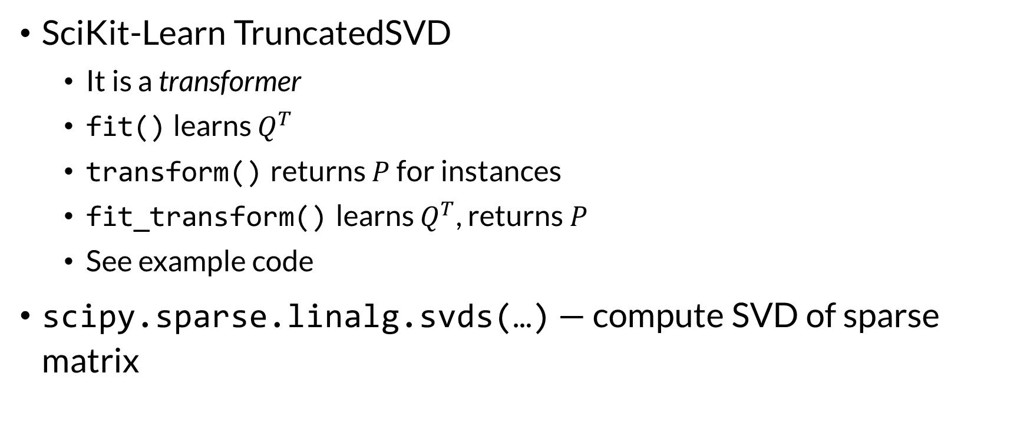
How?
SciKit-Learn TruncatedSVD
It is a transformer
fit() learns $Q^{T}$
transform() returns $P$ for instances
fit_transform() learns $Q^{T}$, returns $P$
See example code
scipy.sparse.linalg.svds(…) — compute SVD of sparse matrix

Slide 10
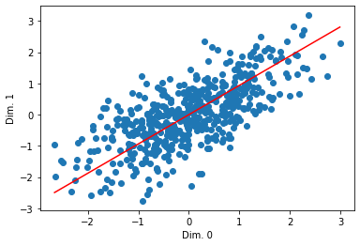
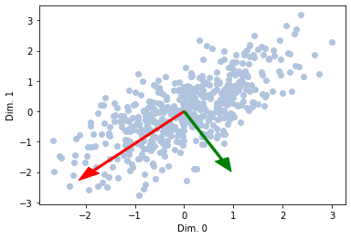
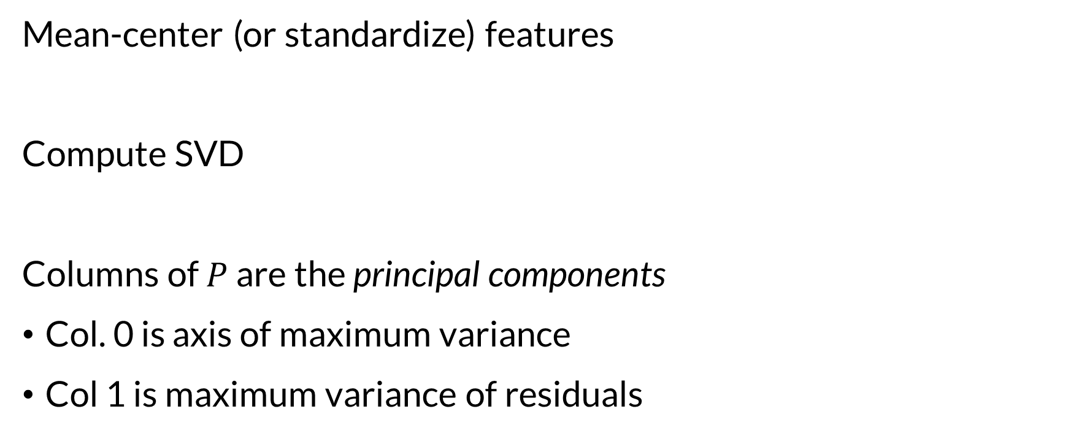

Principal Component Analysis
Mean-center (or standardize) features
Compute SVD
Columns of $P$ are the principal components
Col. 0 is axis of maximum variance
Col 1 is maximum variance of residuals

Slide 11
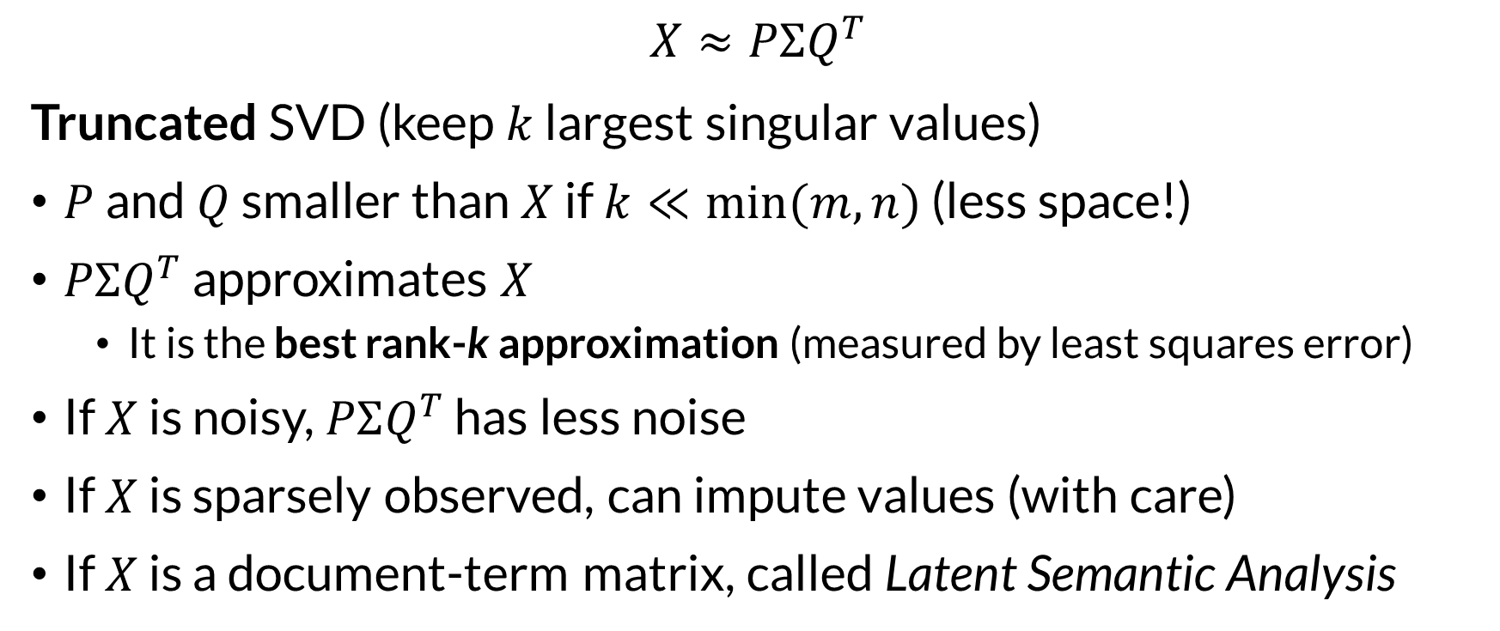
Use Case 1: Compression & Denoising
$$X≈PΣQ^{T}$$
Truncated SVD (keep $k$ largest singular values)
$P$ and $Q$ smaller than $X$ if $k≪min⁡(m,n)$ (less space!)
$PΣQ^{T}$ approximates $X$
It is the best rank-k approximation (measured by least squares error)
If $X$ is noisy, $PΣQ^{T}$ has less noise
If $X$ is sparsely observed, can impute values (with care)
If $X$ is a document-term matrix, called Latent Semantic Analysis

Slide 12
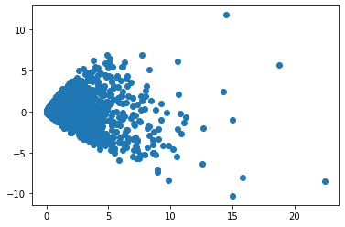
Use Case 2: Visualization
Low-dimensional vectors can be visualized!
See example notebooks

Slide 13
Use Case 3: Better Neighborhoods
High-dimensional spaces have 2 problems for distance:
Distance more expensive to compute
Points approach equidistant in high-dimensional space
Decomposed matrices can improve this!
k-NN classification
k-means clustering

Slide 14
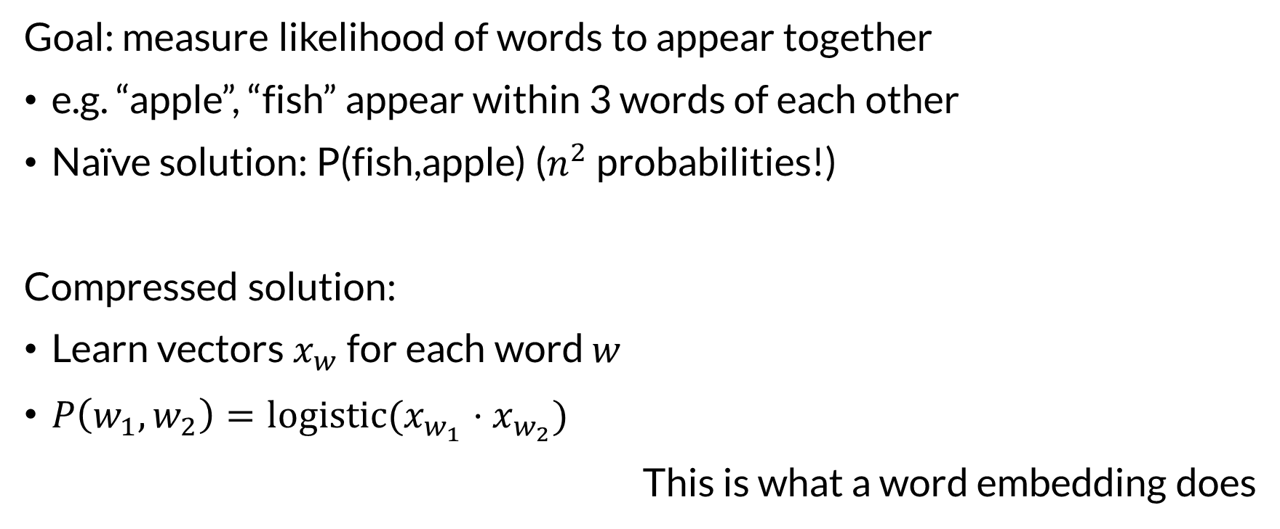
Use Case 4: Categorical Interactions
Goal: measure likelihood of words to appear together
e.g. “apple”, “fish” appear within 3 words of each other
Naïve solution: P(fish,apple) ($n^{2}$ probabilities!)
Compressed solution:
Learn vectors $x_{w}$ for each word $w$
$P\left(w_{1},w_{2}\right)=logistic(x_{w_{1}}⋅x_{w_{2}})$
This is what a word embedding does

Slide 15

Wrapping Up
Matrix decomposition (also called matrix factorization or dimensionality reduction) breaks a high-dimensional matrix into a low-dimensional one.
It preserves distance and, in some configurations, finds the direction of maximum variance.
Photo by Thomas Willmott on Unsplash

